Slide 1



CAPSTONE PROJECT PRESENTATION
Welcome to the culmination of our academic journey. BugBusters Group 1 presents our final capstone project. This presentation showcases our innovative solutions and technical expertise.

Slide 2

Project Supervised By: –
Program Trainer: Mr. Chandan Kr. Naveen. Program Coordinator: Mr. Ronak Ron
The session covered software testing fundamentals, including test case design, various testing, and defect management. The trainer demonstrated hands-on testing with tools like Jira, Selenium, Java and sharing practical scripting techniques and best practices to ensure students gained real-world insights into effective software quality assurance.
The program coordinator managed all aspects of the training, ensuring seamless scheduling, communication, and support for participants. They resolved issues quickly, kept sessions on track, and provided helpful resources. Acting as the main point of contact, they motivated participants, maintained program quality, and ensured an organized, smooth learning experience for everyone.

Slide 3

Our Project Case Studies:
1. Testing IRCTC login Functionality
4. Database Handling of Axis Bank’s “customer_table”
7. Automation Testing on “Test Automation” website
9. Automation Testing on “Rediff Mail registration page”
Click here for Project reference
Bonus:- Axis Bank Login Functionality Testcases.

Slide 4
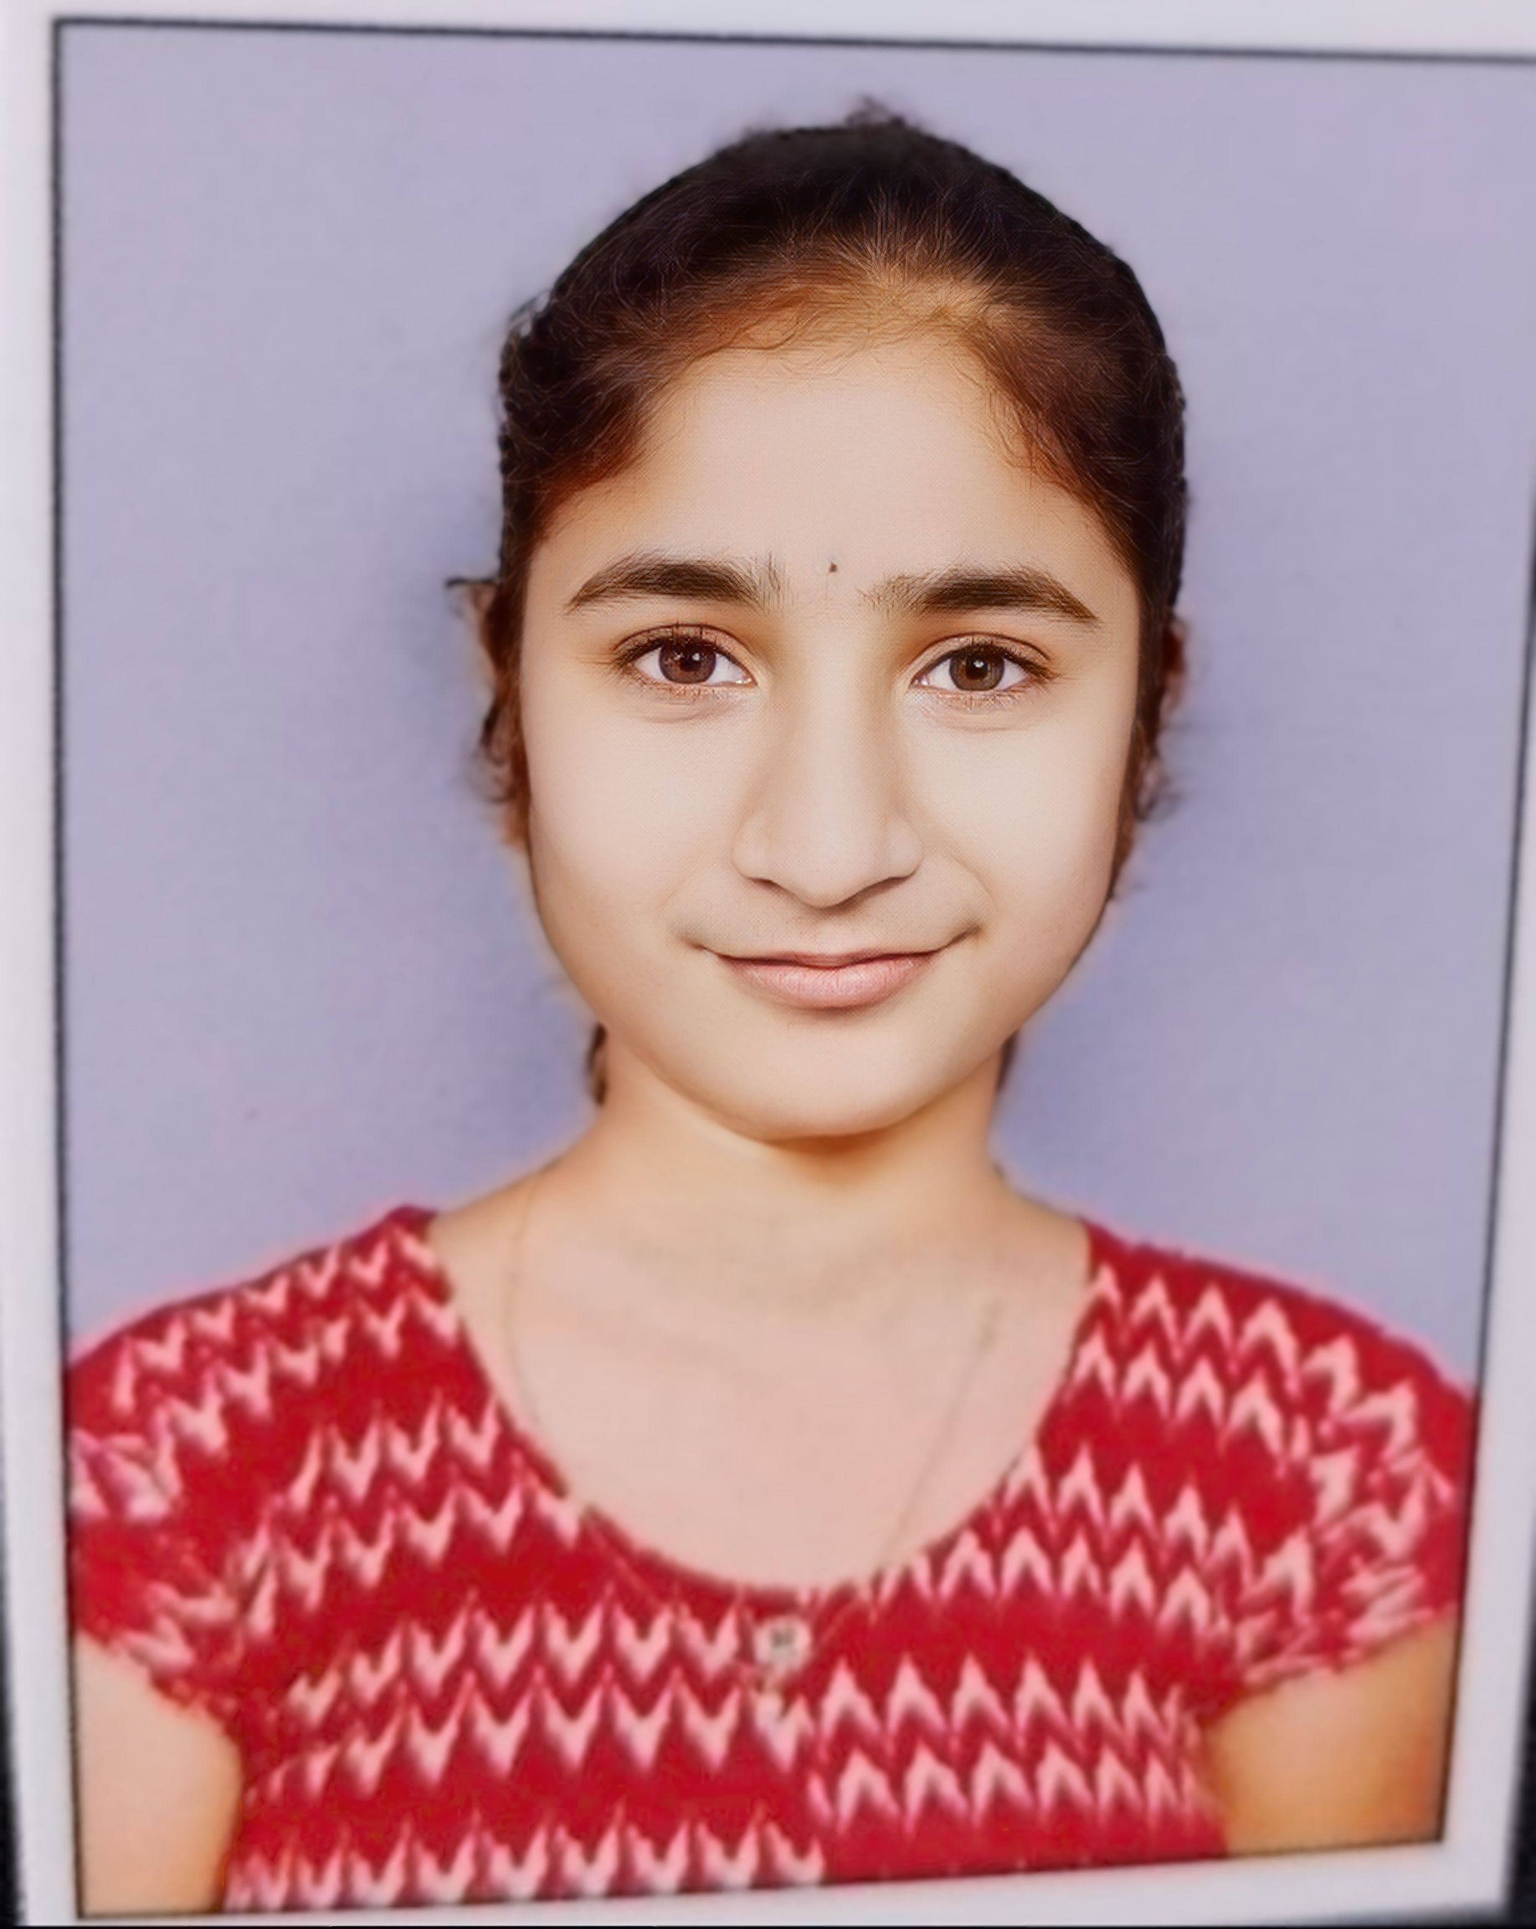

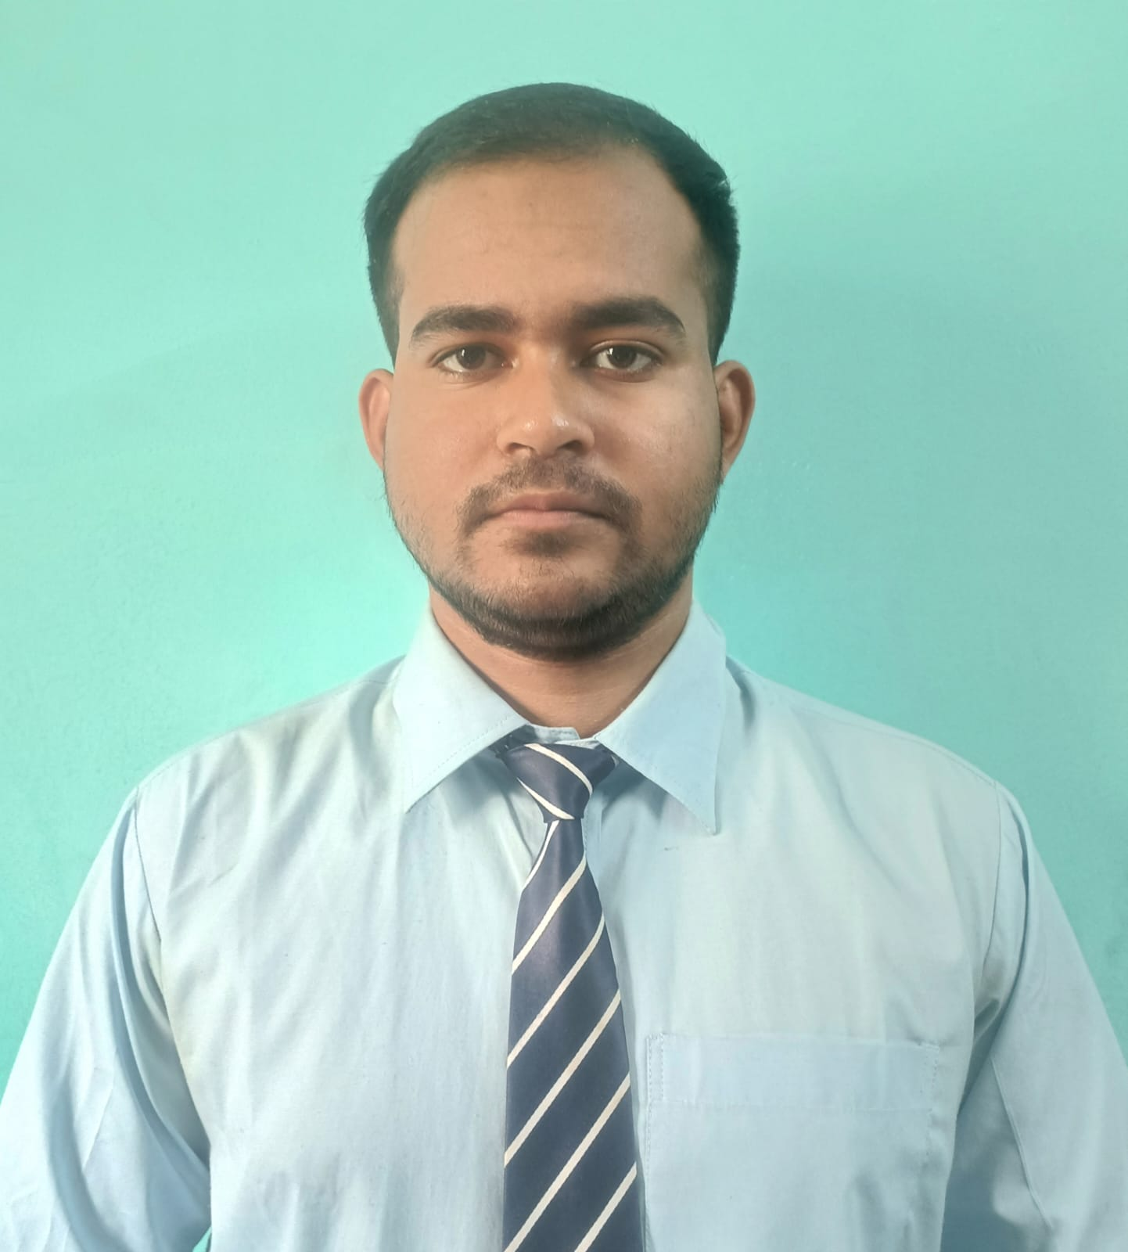
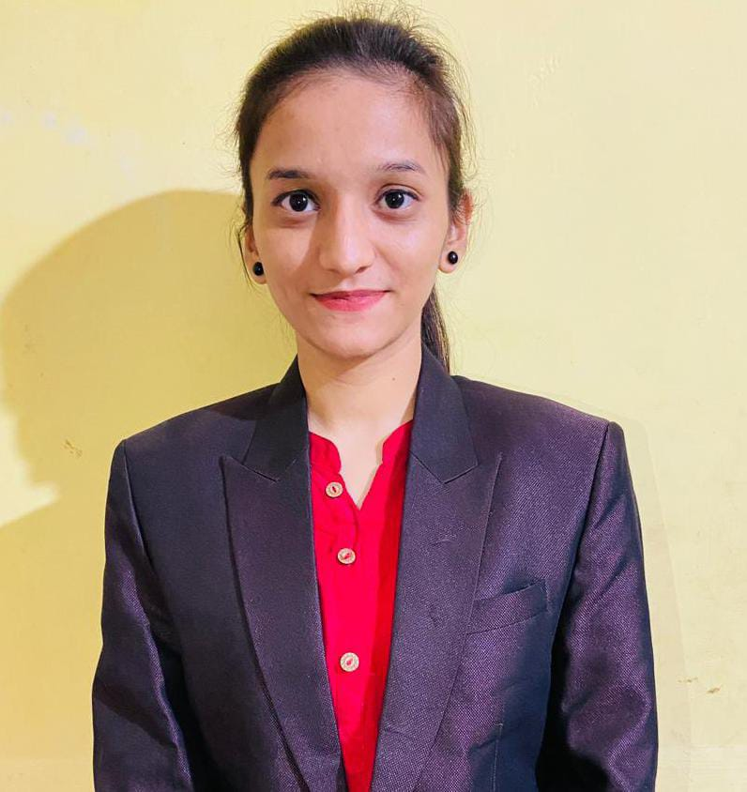

Group Member Details: BUGBUSTERS GROUP1
Shubhadip Paul
Middela Sathvika
Bhabani Sankar Khadiratna
QA trainee, Axis Bank
QA trainee, Axis Bank
QA trainee, Axis Bank
Mansi Santosh Mahale
Ambala Rakesh
QA trainee, Axis Bank
QA trainee, Axis Bank

Slide 5

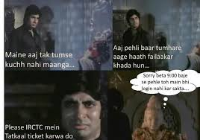
Case study-1 : IRCTC Login Testing Project
Ever feel like the IRCTC login is the real test before you even get to the Tatkal tickets?
“Tatkal booking or Mission Impossible? IRCTC has only one rule: Login first!”
“Leave it Yaar, That’s why we are here” –
By:- BugBusters Group1

Slide 6
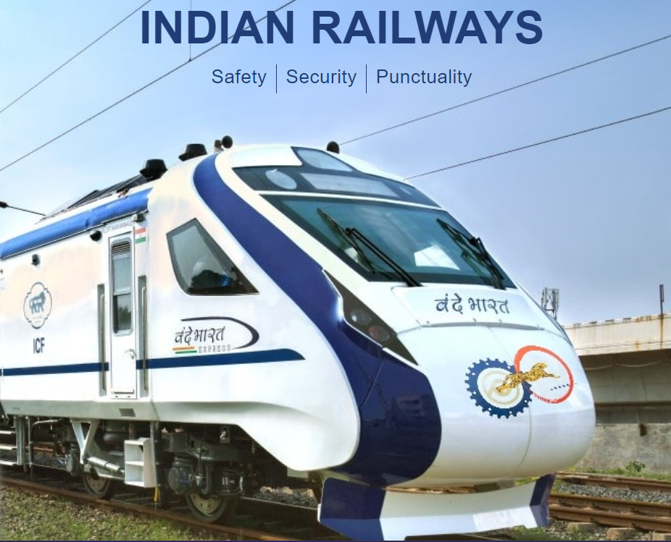
Testing the Login Functionality of the IRCTC Website
The Indian Railway Catering and Tourism Corporation (IRCTC) website serves millions of users daily, making its login functionality a critical component for user experience and security. This presentation outlines a comprehensive approach to testing the IRCTC login system, ensuring robustness, security, and user-friendliness.
Our testing strategy encompasses writing high-level scenarios, developing detailed test cases, and creating a Requirement Traceability Matrix (RTM) for the login page. This thorough examination will validate input handling, error messaging, and overall functionality across multiple browsers, providing a solid foundation for a reliable and secure login process.

Slide 7




Tools and Resources
Test Management - JIRA
Documentation – MS Word , Excel
Browser Compatibility
JIRA serves as the central hub for test case management and bug tracking. Its robust features enable the team to create, assign, and monitor test cases efficiently. The platform's customizable workflows facilitate seamless communication between testers and developers, ensuring quick resolution of identified issues.
Microsoft Excel is utilized for structured documentation of test cases and the RTM. Its powerful sorting and filtering capabilities allow for easy organization and analysis of test data. Custom templates are created to standardize test case formats and maintain consistency across the testing process.
Chrome is the primary browser used for testing, representing a significant portion of IRCTC's user base. Manual testing are done to expand coverage to other browsers and versions, ensuring a consistent login experience across various platforms.

Slide 8
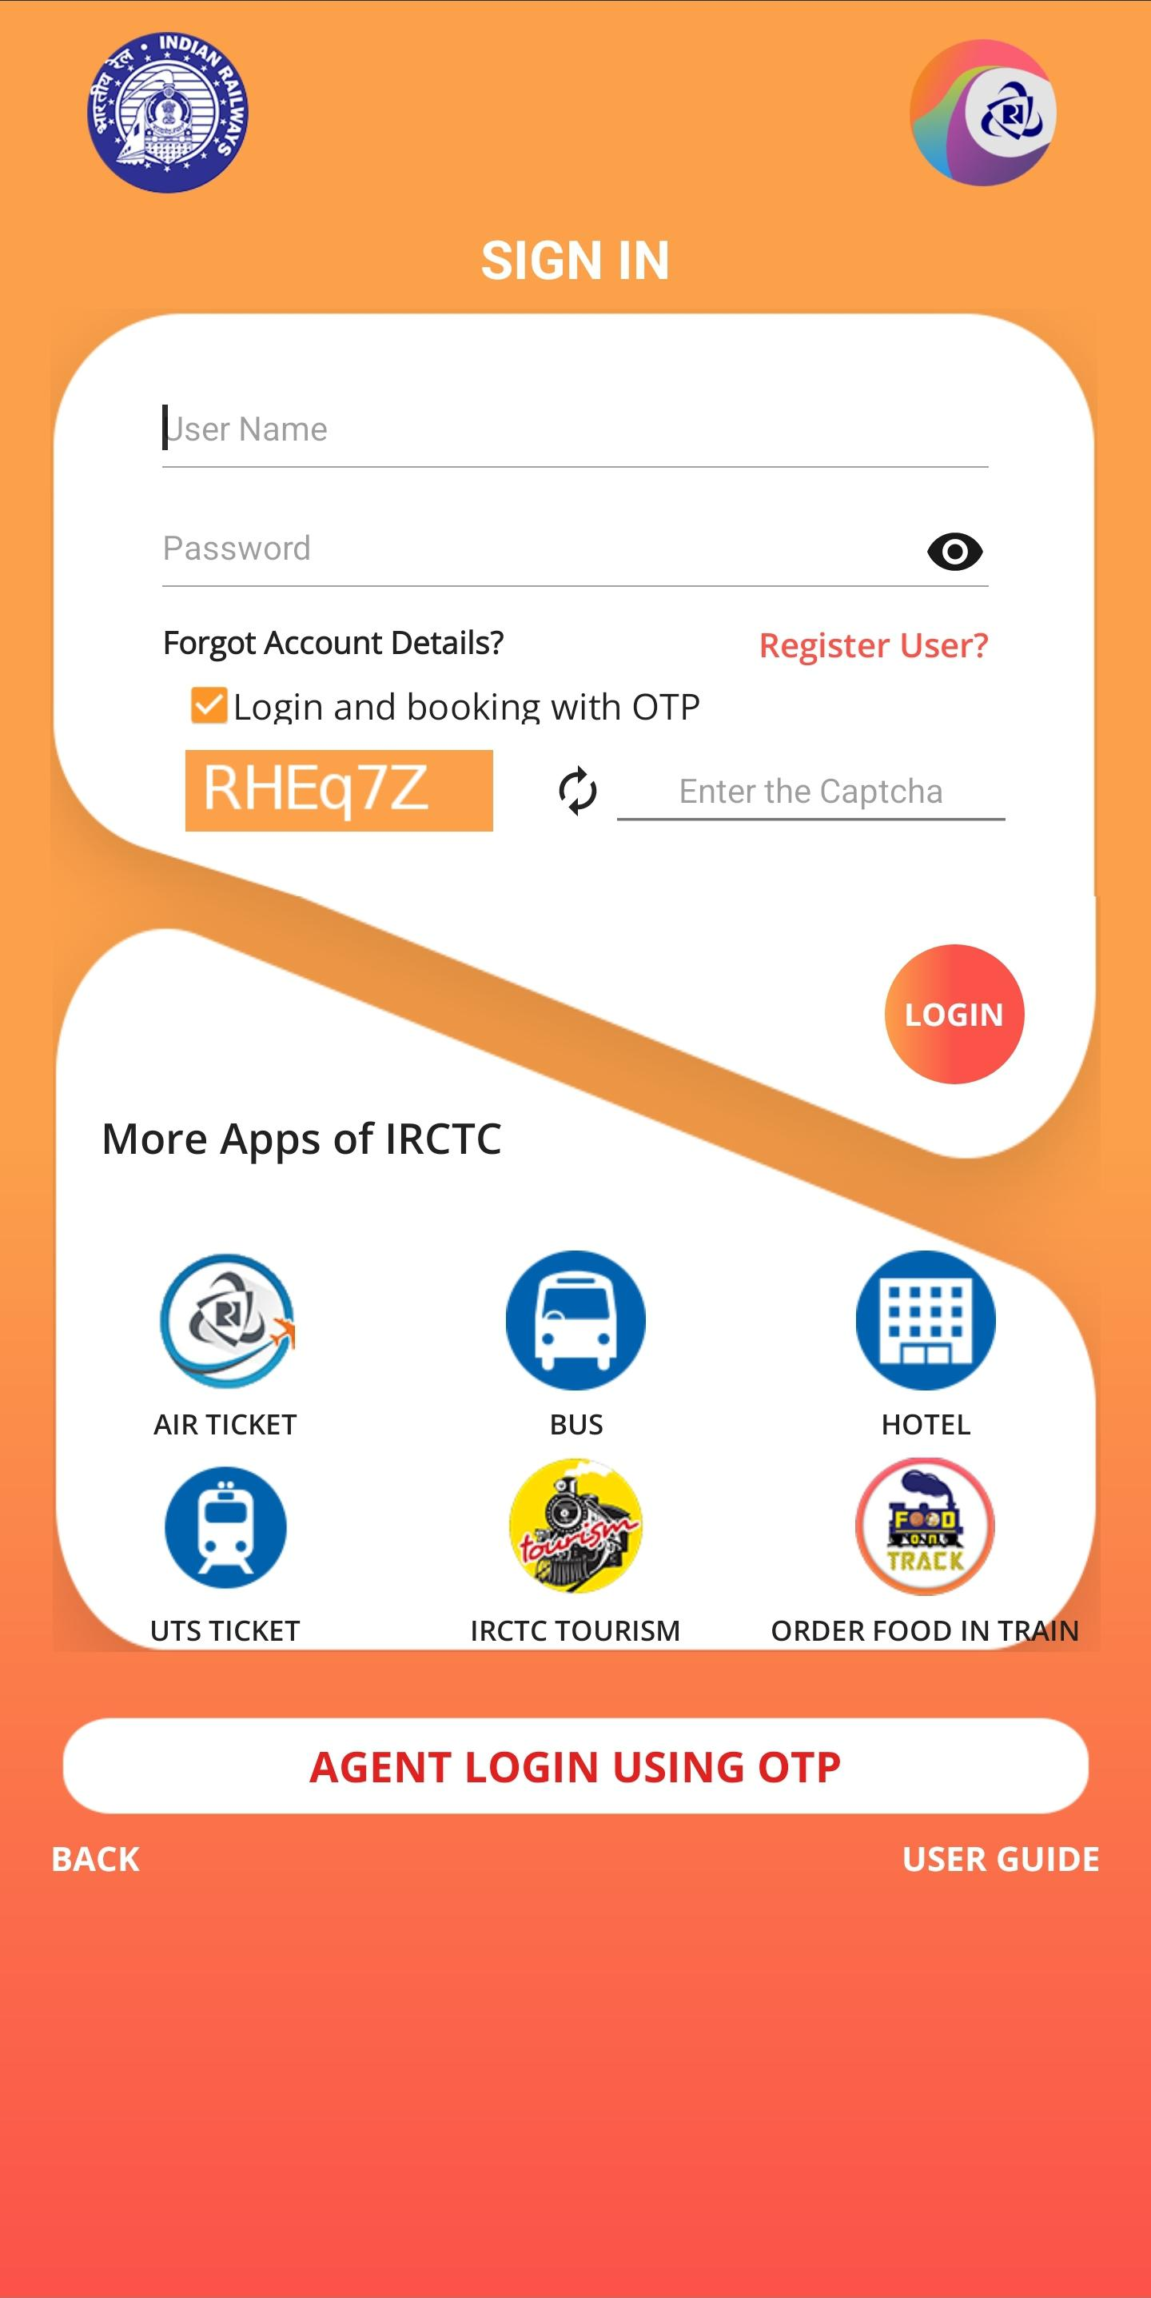
Project Objective & Scope
1
Validate Functionality
Thoroughly test the IRCTC login system for robustness, security, and user-friendliness. This includes assessing various login attempts, input validation mechanisms, and error handling procedures.
2
Enhance Security
Focus on improving security measures by ensuring accurate and informative error messages that don't compromise system integrity. Implement and test strong password policies and multi-factor authentication options.
3
Improve Accessibility
Ensure the login page is accessible across different devices and assistive technologies. Test for keyboard navigation, screen reader compatibility, and responsive design elements.
4
Establish Traceability
Create a comprehensive Requirement Traceability Matrix (RTM) to map test cases to specific requirements, ensuring complete coverage of all login functionality aspects.

Slide 9

Roles and Responsibilities
Bhabani Sankar Khadiratna
Project Lead, TC_LOGIN_001 to TC_LOGIN_008
Shubhadip Paul
TC_LOGIN_009 to TC_LOGIN_016
Ambala Rakesh
TC_LOGIN_017 to TC_LOGIN_024
Middela Sathvika
TC_LOGIN_025 to TC_LOGIN_032
Mansi Santosh Mahale
TC_LOGIN_033 to TC_LOGIN_040

Slide 10
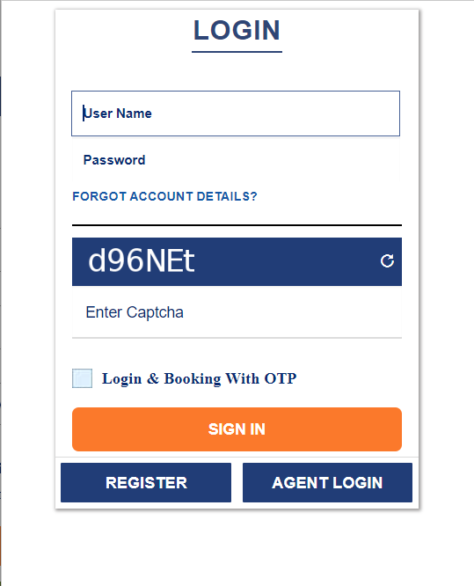
Test Closure Report - IRCTC
Metric
Value
Description
Total Test Cases
40
Comprehensive coverage of login functionalities
Passed
40
All test cases executed successfully
Failed
0
No failures observed during testing
Defects (Unresolved)
0
No open issues at test closure
The test closure report indicates a successful completion of the IRCTC login functionality testing. The 100% pass rate suggests a robust implementation that meets all specified requirements.
Click here for Project Reference.

Slide 11

Case Study 4: Axis Bank’s Customer Database Handling.
So definitely we can not maintain like this for our Axis Bank’s Database operation.
That’s Why We, “The Database Testing” Team Are Here
By:- BugBusters Group1
Or neither we can just put all things like this.

Slide 12


Tools and Resources
Jira Test management tool
Used for Managing the Project status report.
SQL server management
Used for executing the SQL commands and managing the database.
FRD Documentation
Word or Markdown for documenting test cases and results.

Slide 13
Project Deliverables
The project deliverables include the successful creation of the AxisBank_customer table and the insertion of 20 customer records. Additionally, the project requires the development and execution of SQL queries to retrieve data based on specific criteria, including retrieving all customers with verified KYC status, calculating balances for customers who have completed KYC, determining the average balance limit for a specified state, displaying names of customers with a credit limit greater than 45,000, and showing customers' names with expiry dates after 2025 and credit limits above 50,000.
1
Table Creation
2
Data Insertion
Successfully create the AxisBank_customer table.
Insert 20 customer records.
3
Query Execution
4
Data Validation
Develop and execute SQL queries to retrieve data based on specific criteria.
Validate KYC statuses and credit limits.

Slide 14
Roles and Responsibilities
Roles
Responsibility
Ambala Rakesh & Shubhadip Paul
Create SQL table, design schema, write queries
Mansi Santosh Mahale
Create and insert customer data
Middela Sathvika
Create and run queries 2, 3, and 4
Bhabani Sankar Khadiratna
Create and run queries 5 and 6

Slide 15

Test Closure Report
The objective of the test closure report is to confirm that all requirements have been met and the testing phase for the SQL operations on the Axis Bank customer data is complete. All 6 test cases were passed, resulting in 0 failed tests. All SQL operations and customer data requirements are tested and covered by queries. No defects were found during the testing process.
Click here for Project Reference.
Test Case
Result
Table Creation
Passed
Data Insertion
Passed
Query 1
Passed
Query 2
Passed
Query 3
Passed
Query 4
Passed
Query 5
Passed
Query 6
Passed

Slide 16
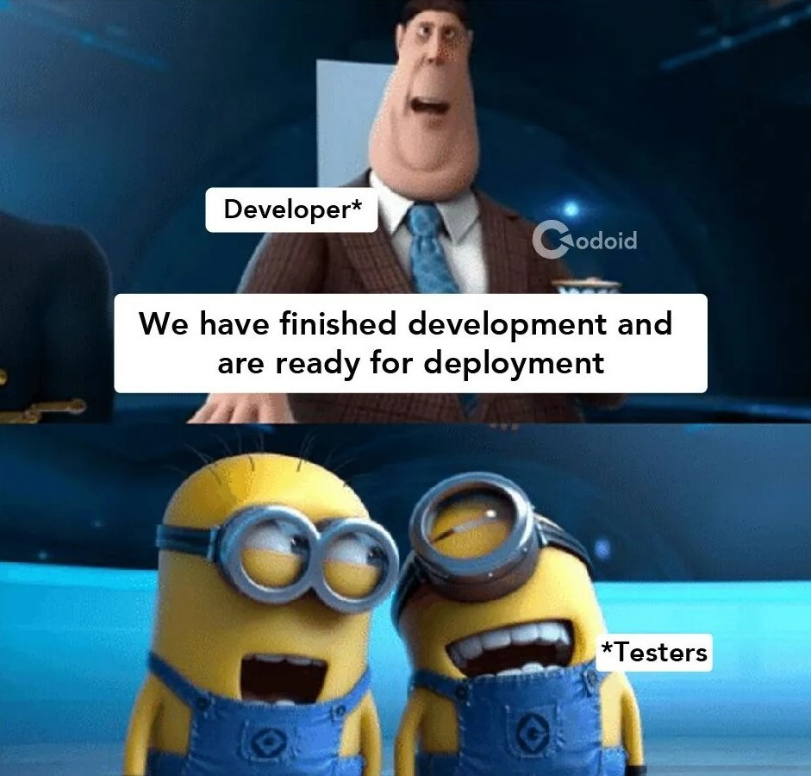
Case study-7 : Automation Testing on “Test Automation Practice” website
“Let’s see if the testing practice site is ready for the real world!”
“Making Sure the Testing Site is Test-Worthy!”
“Leave it Yaar, That’s why we are here” –
By:- BugBusters Group1

Slide 17


Automation Testing on "Test Automation Practice" Website
This project aims to automate the testing of the web form functionality available on the Test Automation Practice website. The primary focus is on verifying input handling for various fields, ensuring proper functionality of the form, and validating user interactions with the webpage.

Slide 18




Tools and Resources
Jira Test management tool
Google Chrome
Used for Managing the Project status report.
Primary browser for executing
the automation tests.
Eclipse IDE
FRD Documentation
Used for Writing the Java Codes.
Word or Markdown for documenting
test cases and results.
Java programming language
Selenium WebDriver
Programming language used for
scripting the automation tests.
Used for browser automation in testing
the registration functionality.

Slide 19
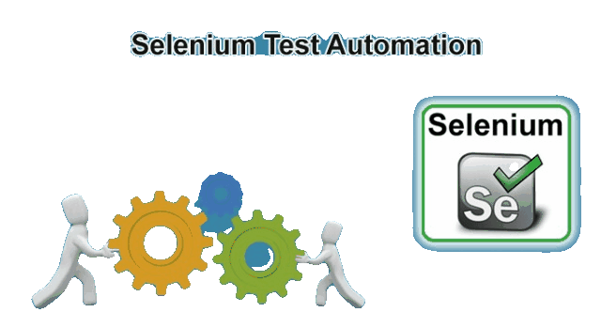
Project Deliverables
Selenium Automation Script
Develop a complete automation script using Selenium in Java.
Launch the website.
Enter, clear, and print values for name, email, and phone number fields.
Select a country and color from the provided options.
Test Documentation
Document the automation test cases and their results, including any identified issues.

Slide 20
Roles and Responsibilities
Mansi Santosh Mahale
Launch the Website of Test Automation and Enter the name in Name Section,
Ambala Rakesh
Clear the Name and enter new name, Print the value of name.
Shubhadip Paul
Enter email address, Clear email address and enter new email address, Print the value of email address.
Bhabani Sankar Khadiratna
Enter the Phone number, Print the value of Phone number.
Middela Sathvika
Select any Country, Select any Colour.

Slide 21
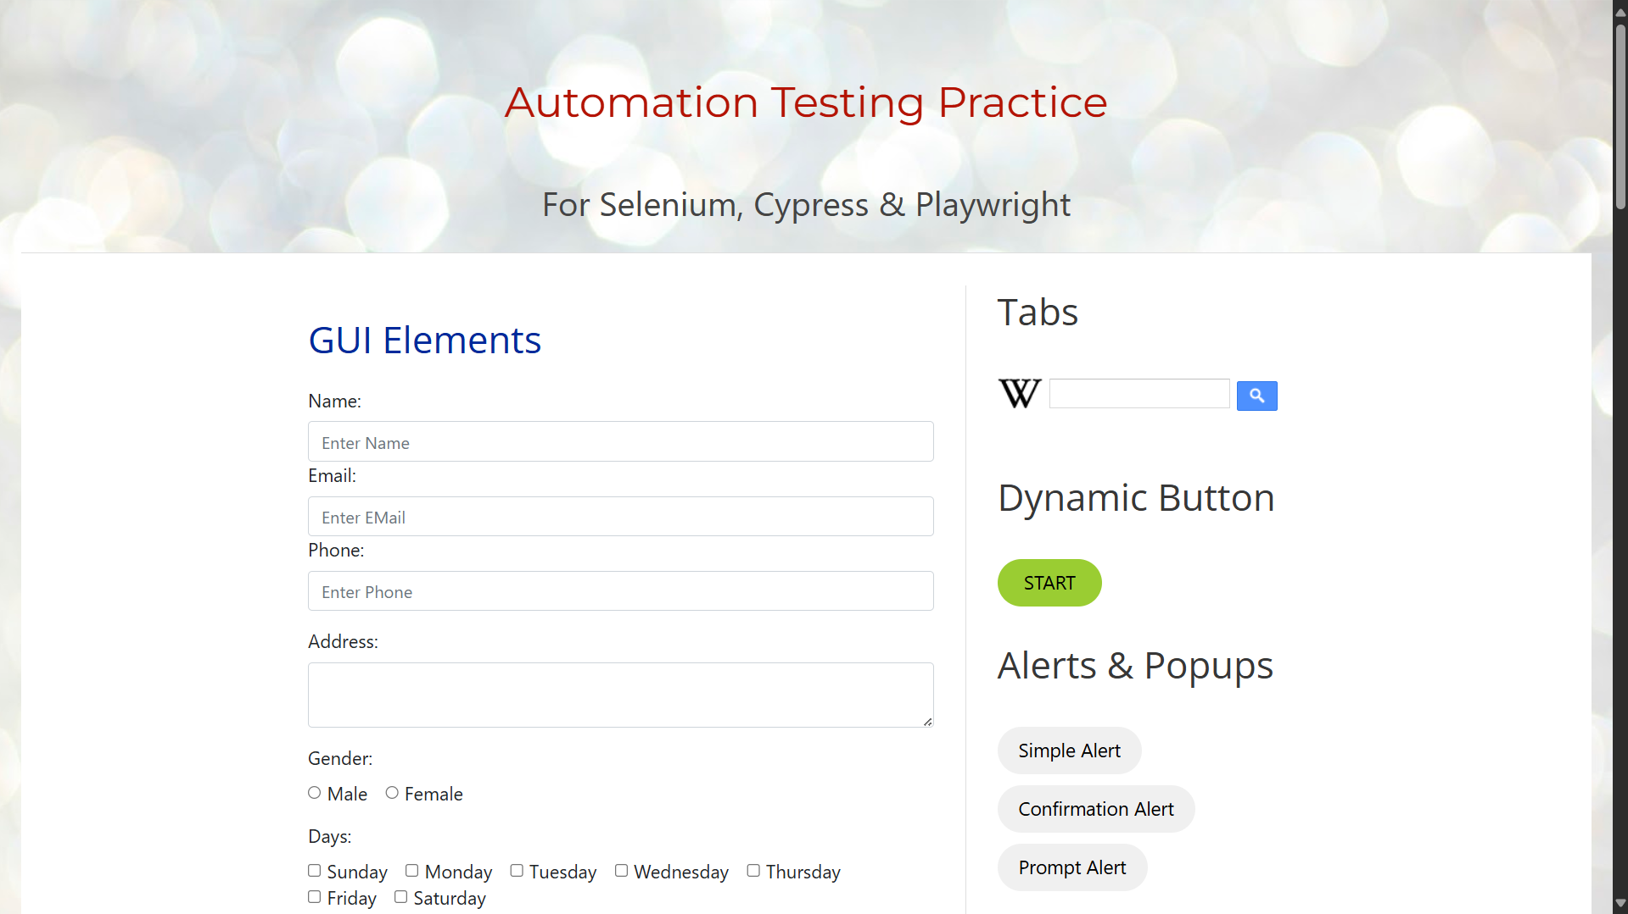
Test Closure Report Summary
Metric
Value
Description
Total Test Cases
11
All the test cases tested and covered by the automation script.
Passed
11
All test cases executed successfully
Failed
0
No failures observed during testing
Defects (Unresolved)
0
No open issues at test closure
All web form functionalities requirements are tested and covered by the automation script.
Click here for Project Reference.

Slide 22


Case study-9: Automation Testing of RediffMail Registration
This project aims to automate the testing of the user registration functionality on the Rediff registration page. The focus is on verifying input handling and ensuring the registration form operates correctly through automation. The project will validate user interactions, input fields, and the overall functionality of the registration process using Selenium WebDriver with Java.
The scope includes launching the website, maximizing the webpage, validating the page title, and input validation for various fields such as full name, email, password, alternate email, and mobile number. The project will deliver a complete automation script and comprehensive test documentation.

Slide 23
Tools and Resources
Jira Test management tool
Google Chrome
Used for Managing the Project status report.
Primary browser for executing
the automation tests.
Eclipse IDE
FRD Documentation
Used for Writing the Java Codes.
Word or Markdown for documenting
test cases and results.
Java programming language
Selenium WebDriver
Programming language used for
scripting the automation tests.
Used for browser automation in testing
the registration functionality.

Slide 24
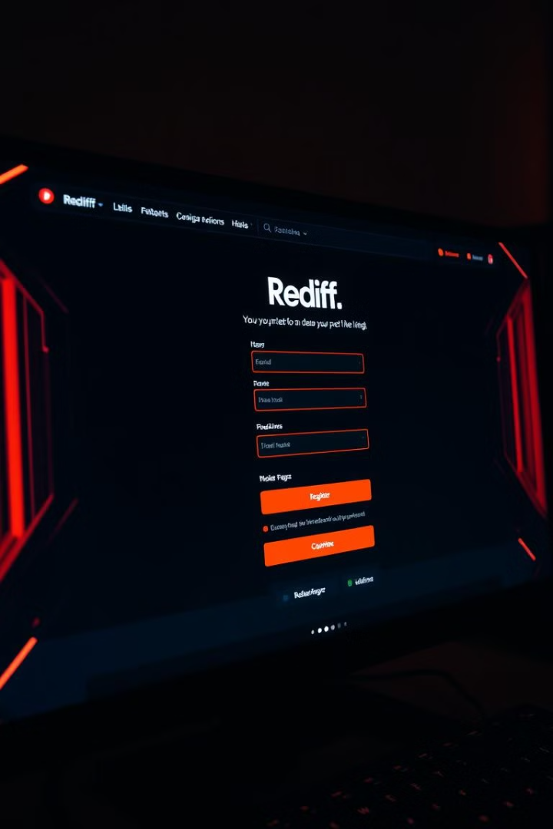




Project Deliverables
For the Rediff registration page, we will create another Selenium script to automate the testing process. This script will handle various form inputs and perform actions such as maximizing the browser window and retrieving page information.
Launch and Maximize
Open the Rediff registration page and maximize the browser window
Page Information
Retrieve and print the page title
Form Interaction
Enter and verify various form fields such as name, email, and password
Data Retrieval
Get and print entered information like full name and phone number

Slide 25
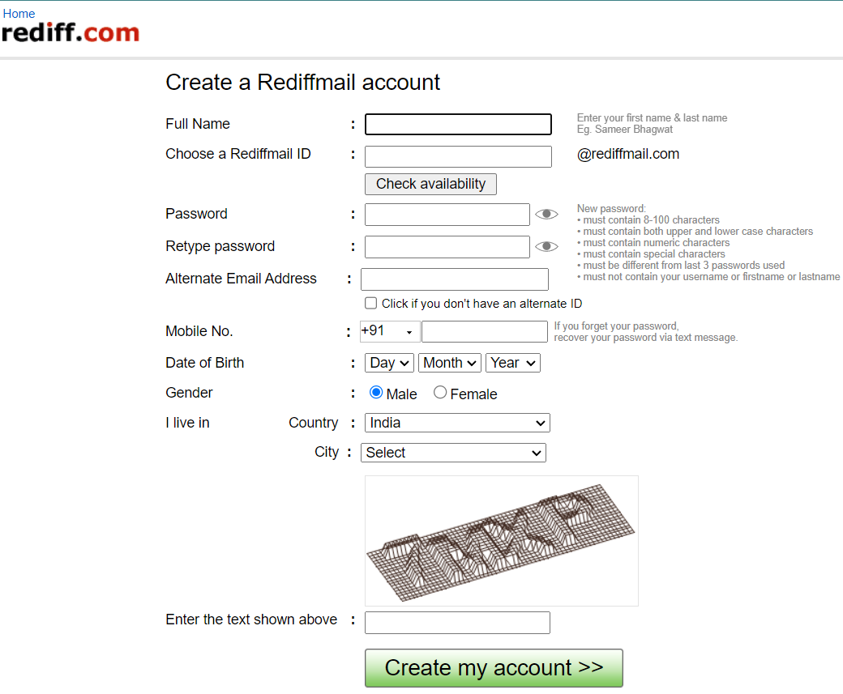
Test Closure Report – Rediff Mail
Metric
Value
Description
Total Test Cases
11
Comprehensive coverage of Registration functionalities
Passed
11
All test cases executed successfully
Failed
0
No failures observed during testing
Defects (Unresolved)
0
No open issues at test closure
All registration form functionalities and user interaction requirements are tested and covered by the automation script.
Click here for Project Reference.

Slide 26


Bonus: Testing Axis Bank Login Page
This project aims to validate the login functionality of Axis Bank's Internet Banking page. It focuses on testing the complete login process for security, user-friendliness, and efficiency.

Slide 27

Tools and Resources
Test Management - JIRA
Documentation – MS Word , Excel
Browser Compatibility
JIRA serves as the central hub for test case management and bug tracking. Its robust features enable the team to create, assign, and monitor test cases efficiently. The platform's customizable workflows facilitate seamless communication between testers and developers, ensuring quick resolution of identified issues.
Microsoft Excel is utilized for structured documentation of test cases and the RTM. Its powerful sorting and filtering capabilities allow for easy organization and analysis of test data. Custom templates are created to standardize test case formats and maintain consistency across the testing process.
Chrome is the primary browser used for testing, representing a significant portion of Axis Bank’s user base. Manual testing are done to expand coverage to other browsers and versions, ensuring a consistent login experience across various platforms.

Slide 28

Project Objective
1
Comprehensive Testing
2
Security Focus
3
User Experience
Validate successful and unsuccessful login attempts, input validations, and error handling.
Ensure secure account access while minimizing login errors.
Confirm the login process is efficient and user-friendly.

Slide 29
Roles and Responsibilities
Ambala Rakesh
Project Lead, Dashboard and Services Test Cases
Mansi Santosh Mahale
Accounts and Loans Test Cases
Shubhadip Paul
Term Deposits and Credit Cards Test Cases
Bhabani Sankar Khadiratna
Payments and Insurance Test Cases
Middela Sathvika
Investments Test Cases

Slide 30
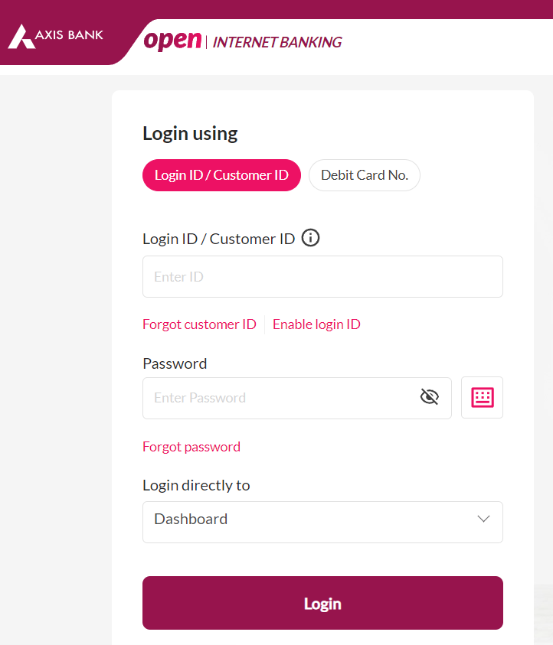
Test Closure Report – Axis Bank
Metric
Value
Description
Total Test Cases
81
Comprehensive coverage of login functionalities
Passed
81
All test cases executed successfully
Failed
0
No failures observed during testing
Defects (Unresolved)
0
No open issues at test closure
The test closure report indicates a successful completion of the Axis Bank login functionality testing. The 100% pass rate suggests a robust implementation that meets all specified requirements.
Click here for Project Reference.

Slide 31

Thank You

